Slide 1
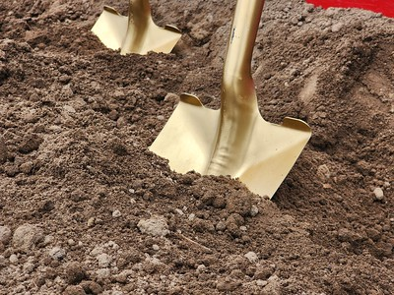
MODULE 2:
Soil Properties, Principles of Soil Health and Small Farms

Slide 2
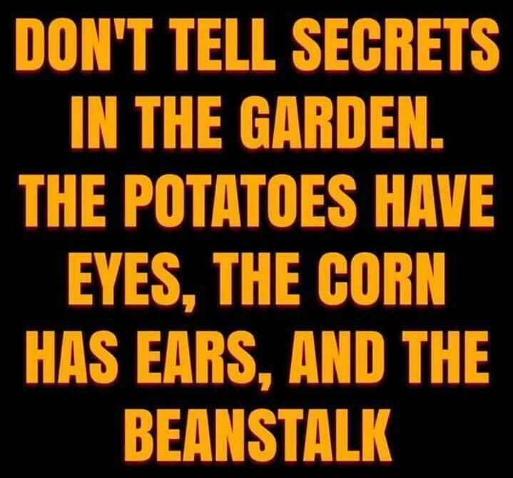
Garden joke image
Notes:
Soil health is fun! Instructors are encouraged to add appropriate cartoons and jokes to increase class participation and learning.

Slide 3
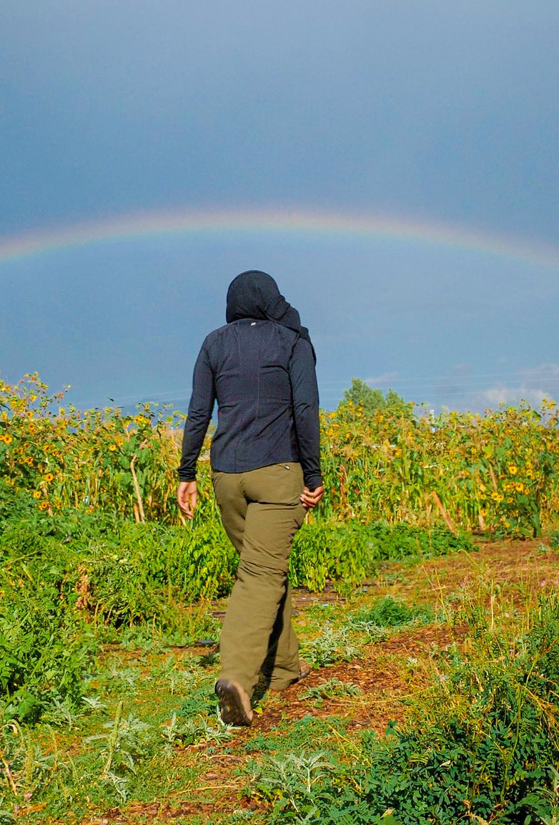
Objectives
Establish a baseline of understanding of:
The difference between soil inherent properties and soil health as well as the four principles of soil health and what that looks like on small farms.
Enable participants to communicate these concepts to producers.
Train participants in how to identify soils with healthy and unhealthy biological function.

Slide 4

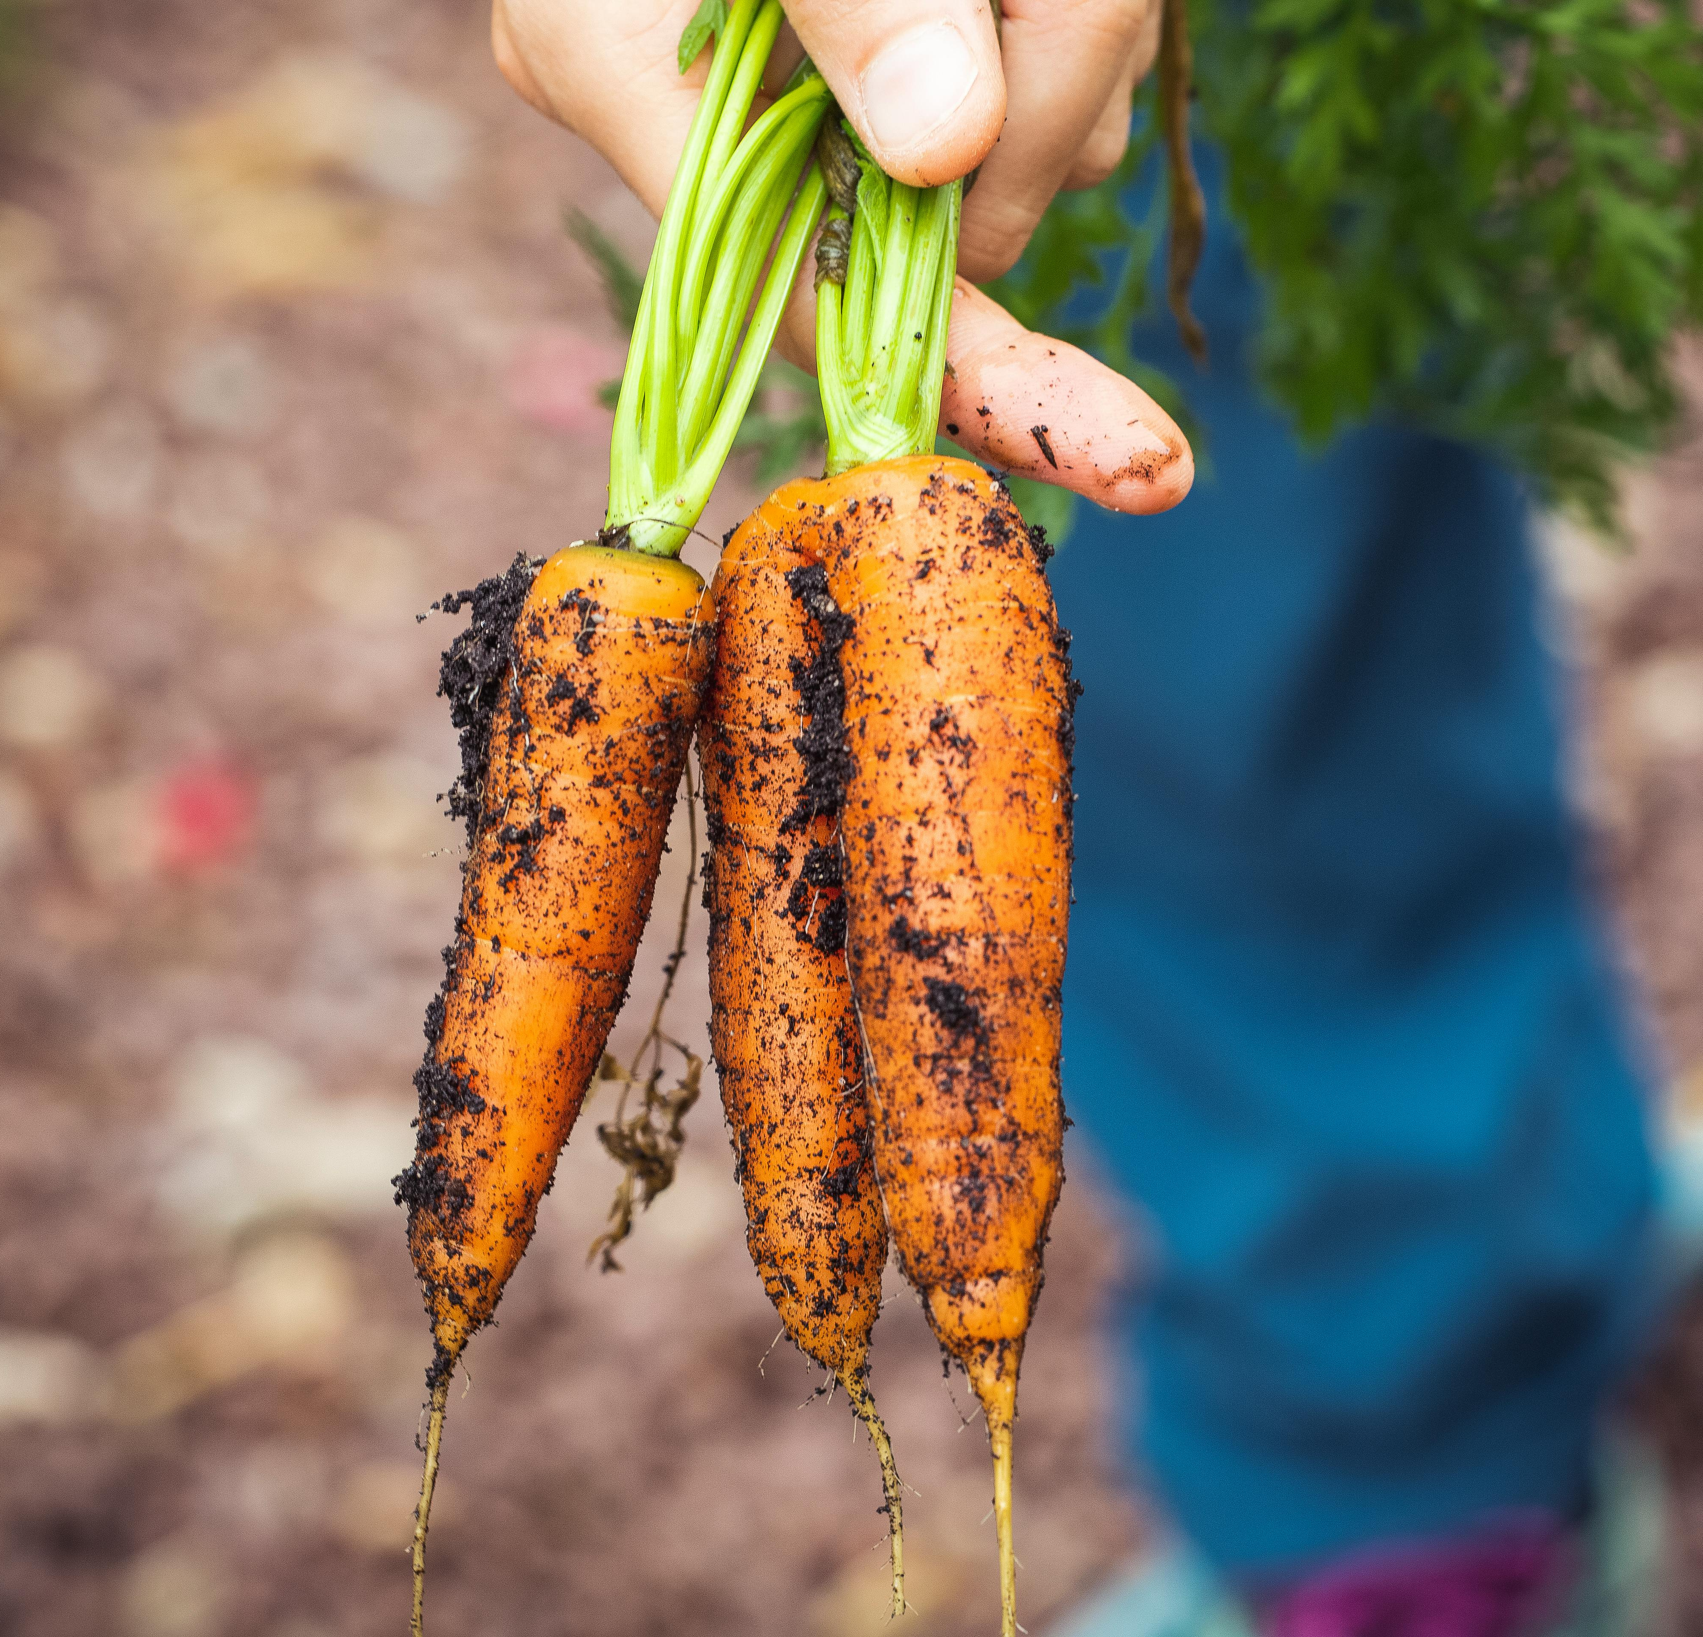
How Does NRCS Define Soil Health?
The continued capacity of the soil to function as a vital living ecosystem that sustains plants, animal and humans.
Notes:
This definition focuses on the importance of soil function and soil as a living resource. When we speak of soil health, we are talking about improving the capacity of soil to function as a vital, living ecosystem that sustains plants, animals, and humans.
“Health” is usually used in the context of a living organism so managing soils for optimum health, in a way, ensures they are sustainable/alive for future generations.
This is the definition of Soil health we are using. The term “Health” was purposely chosen instead of “quality”.
Quality implies analysis and quantifying
Health implies management actions that leads to a condition or state, there is something that can be done to change it to a positive trend
The key to the definition is that soil health is:
Continued capacity—implies rejuvenation and then sustainability
Soil is a living ecosystem– recognize the ground beneath as a living ecosystem (Land use and ecosystem boundaries)
Soil function – soils need to provide the basic functions for food & fiber production.
How well is your soil functioning to feed and water your plants?
this definition focuses our efforts on the importance of managing soils within ecosystem and land use boundaries we are presented with, in a way that ensures they are sustainable for future generations. (Focus is on Management

Slide 5
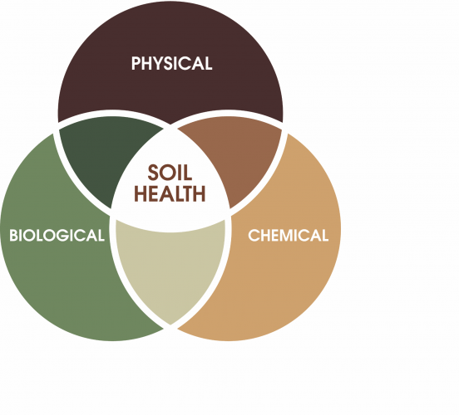
Three Properties of Soils
Soil health is determined by all three major classes of soil properties and their interaction.
Wholistic approach
Biological Properties not as well understood as chemical and physical properties of soil.
Soil biology can influence aggregation, infiltration, organic matter and nutrient availability.
Notes:
The physical properties of soil typically refer to the structure of the soil matrix. Specific physical properties typically considered are aggregate stability (the soil’s ability to maintain structure when exposed to stress), soil penetrometer resistance (an indication of compaction), and available water capacity (how much plant-available water is held within the soil matrix).
The chemical components of the soil are measures of the soil’s acidity (pH), salinity, organic matter, and nutrient content. The nutrient content includes the macronutrients nitrogen (N), phosphorus (P), and potassium (K); the secondary nutrients calcium (Ca), magnesium (Mg), and sulfur (S); and the micronutrients zinc (Zn) and copper (Cu).These chemical properties help determine what nutrients are available to plants and other living things.
The biological properties of the soil are typically characterized by the size and composition of the biological community and the rate of biological processes like mineralization (i.e., conversion from organic to mineral forms) of carbon and nitrogen from soil organic matter. Good biological soil health is associated with high rates of mineralizable nitrogen because nitrogen in soil organic matter is only available to plants and soil microbes after it is mineralized. High rates of mineralizable carbon reflect high soil microbial activity, and soils with healthy microbial communities are generally considered more productive and resilient to stress.
Soil organic matter also helps prevent soil compaction and erosion. The biological component of soil health is directly linked to climate change mitigation because an increase in soil carbon represents a decrease in atmospheric carbon dioxide.
Something unique about the soil health framework, in comparison to

Slide 6
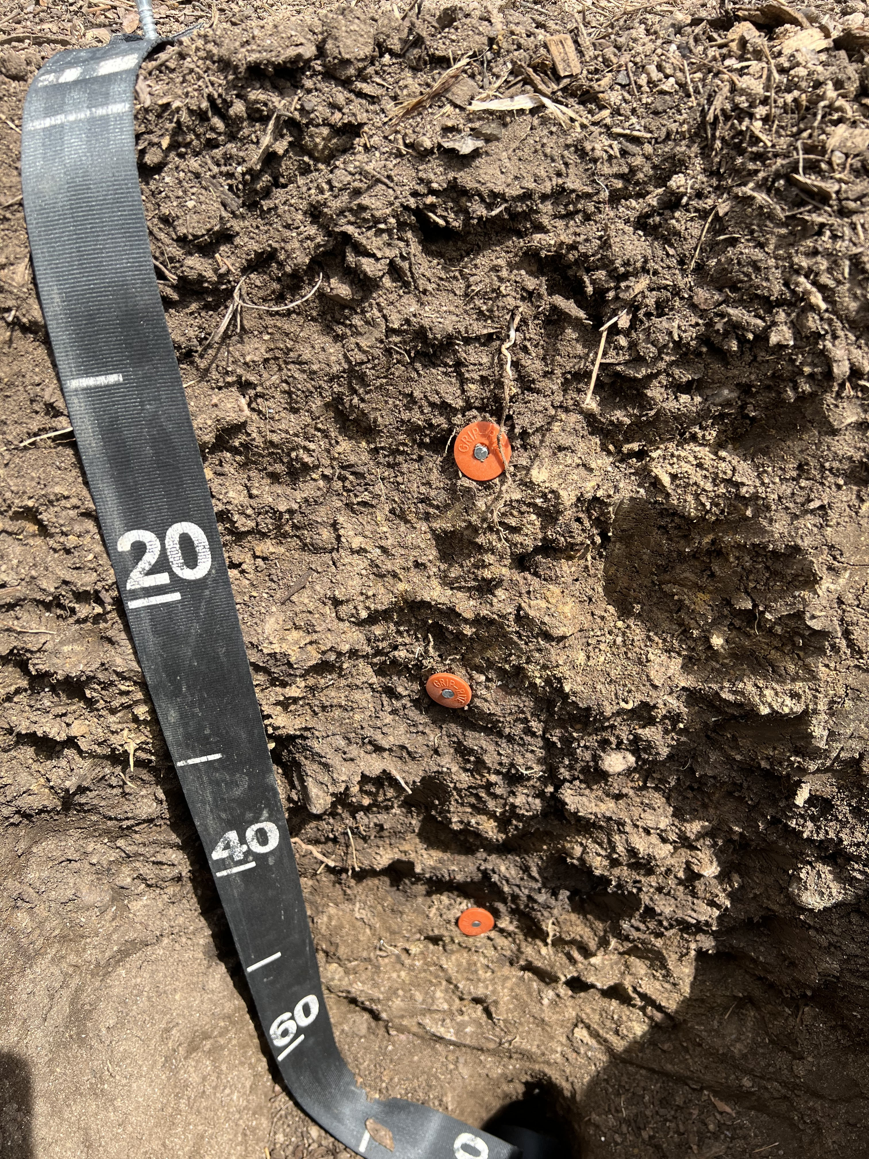
Inherent and Dynamic Soil Properties
Inherent Soil Properties
  Considered fixed and do not change significantly from management
  Determined by natural soil forming processes.
Dynamic Soil Properties
  Can change relatively quickly in response to management, land use, and environmental factors
  Can improve or degrade soil function, depending on management
Notes:
Soil health is also influenced by the interaction of soil properties that are both inherent and dynamic in nature.
Can open this slide with a question to the group – How do you define inherent soil properties ?
Go through bullet points to define each of these concepts.
May also be important to state that, Inherent properties determine a baseline for a soil’s potential, while dynamic properties reflect its current condition and can be managed to enhance soil health and productivity.
Understanding these differences helps guide sustainable soil management practices by focusing on improving dynamic properties while working within the constraints of inherent properties.
Photo: Randy Riddle, USDA NRCS. Soil profile at an urban agriculture site in Denver CO. Soil has good color, structure and root growth (dynamic properties) despite having inherent limitations of shallow depth to restrictive layer.

Slide 7
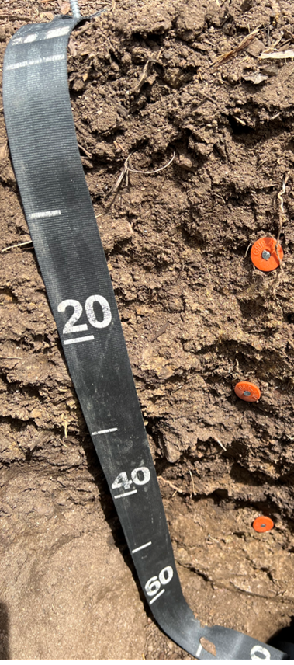
Inherent and Dynamic Soil Properties
Inherent Soil Properties:
  Soil texture
  Depth of soil
  Mineralogy
  Drainage class
Dynamic Soil Properties:
  Organic carbon content
  Structure or aggregation
  Nutrient content
  Biological properties
Notes:
These are examples of both inherent soil properties and dynamic soil properties.

Slide 8
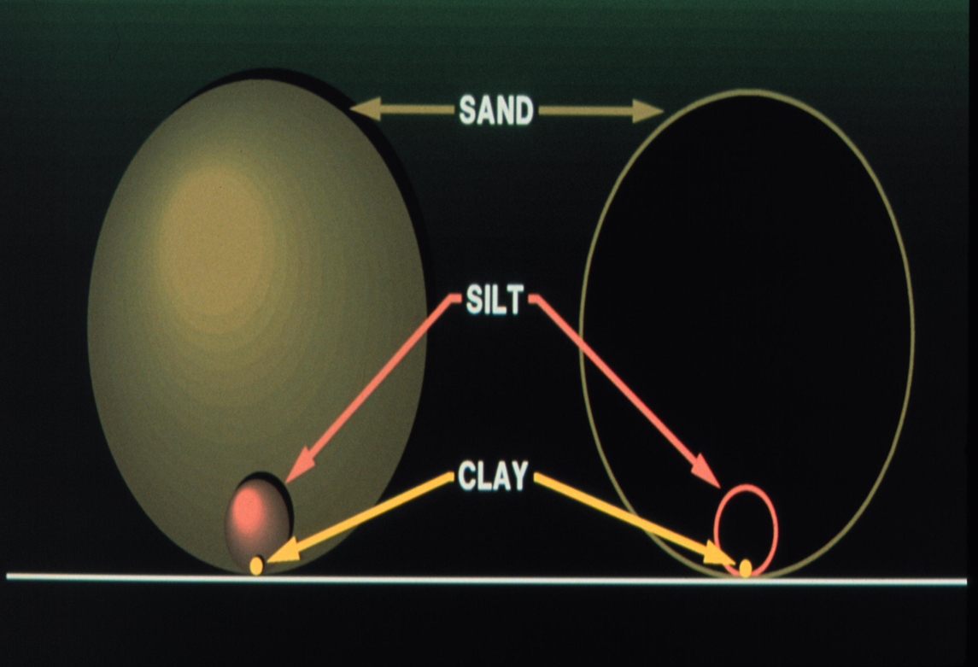
Inherent Soil Properties
Determines how soils function and influences:
  Compaction
  Water Retention
  Chemical Properties (based on parent material or transported sediments)
  Nutrient Retention
    Organic matter and clay have negative charges so can hold onto nutrients better (cation exchange capacity).
Important! Soil Health can improve soil function, but not change inherent soil properties.
Notes:
It is important to understand that soil health practices can improve the functions of a soil but it can’t change an inherent soil property. For example, clay soils will always have problems with compaction. Planting tillage radishes for example may help with drainage but the soils will never drain as quickly as a sandier soil. Adding soil organic matter to sandy soils will help improve cation exchange capacity but it will still have difficulty holding nutrients and water (unless a significant amount of organic matter is added). It is easy to forget about inherent soil properties and limitations when discussing soil health.

Slide 9
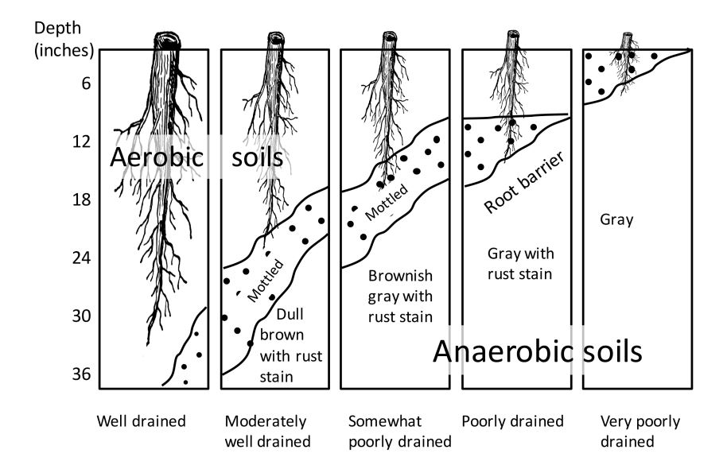
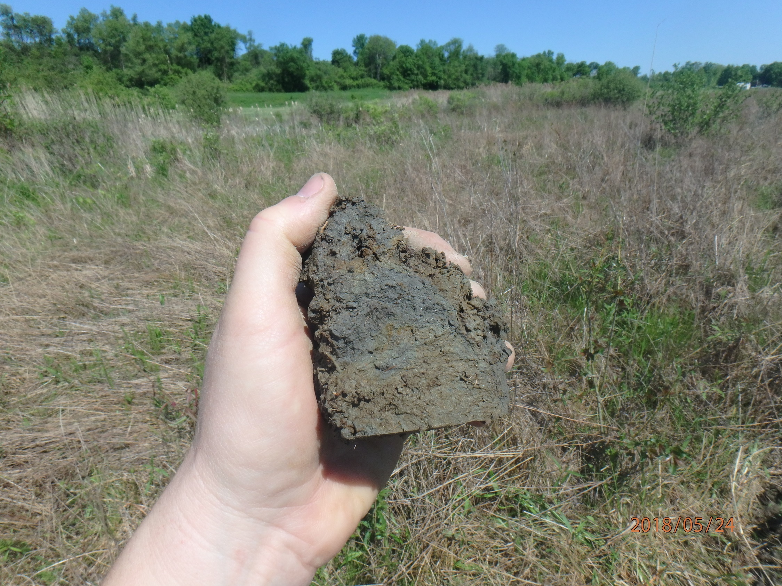
Inherent Soil Property: Drainage Class
Source: Soil and Soil Water Relationships, Virginia Cooperative Extension
Notes:
While compaction through management can cause soils become hydric, typically drainage class is an inherent soil property and dependent on either depth to water table or other restrictive layer like clay. Again, it is important for producers to understand that planting cover crops or switching to no-till will not improve the drainage class. Soil health practices CAN however be a tool to help reduce compaction caused by management.

Slide 10
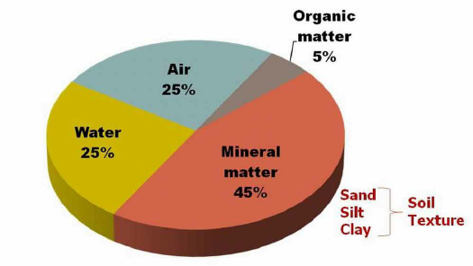
What is Soil Made Up Of?
inherent soil property
Notes:
When we learn about what soil is comprised of, we often see this pie chart showing the ideal composition of soil.

Slide 11
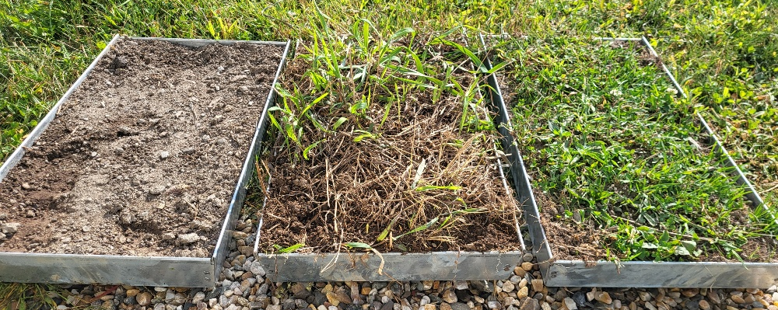
Soil Content Changes With Management (Bulk Density)
Notes:
However the amount of air, water, mineral matter, and organic matter vary greatly with management. On this small farm, the raised beds with added compost had much higher amounts of soil organic matter and air space between soil particles causing the soil to be lighter. On the opposite end, the compacted pasture had less air, less ability to hold water, and less organic matter. Which soil tray would be more susceptible to drought? Which soil tray would need less water?
Same quantity of soils, different management and vastly different weights.

Slide 12
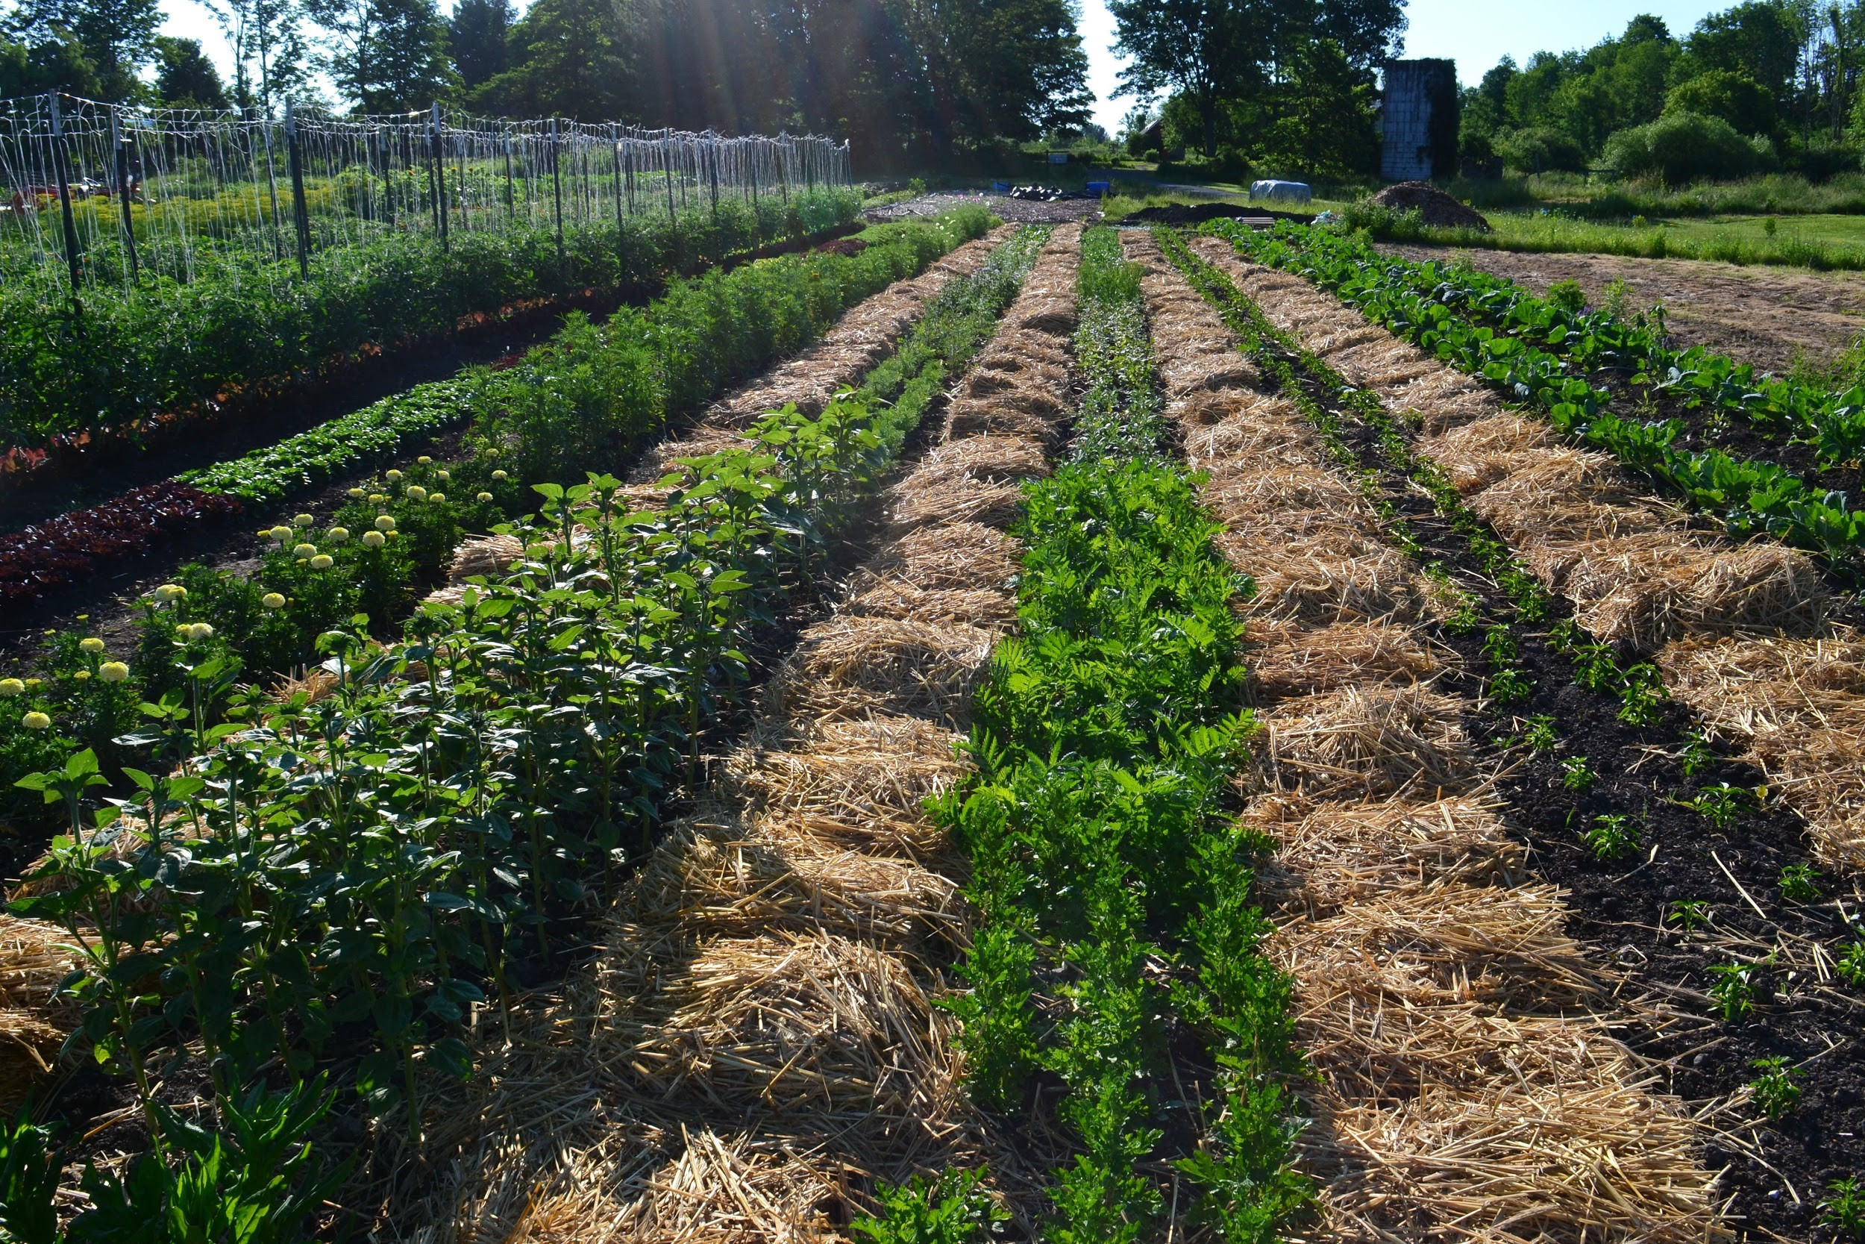
Example: Organic Vegetable Farm - NY
3 acre organic vegetable CSA in NY.
Grosses $125,000 an acre on sub-prime soils (family land).
Minimal irrigation and inputs.
Has to use soil health practices such as permanent beds, no-till, and cover crops.
Notes:
Can substitute another local example. Here is an example of a 3 acre organic vegetable CSA in NY. The farmers inherited land that had subprime soils and was easily compactable. They created permanent beds using the “lasagna” method. First they tarped the rows to kill the vegetation. Next they brought in top soil and laid it out in rows. Next they put a thick layer of straw mulch on top of the rows and plant into that. They also mulch the paths to prevent weeds and moisture loss. Mulching heavily reduces or eliminates the need for irrigation.

Slide 13
How are Soil Properties and Soil Health Different or Important for Urban and Small Farms?
Challenges:
Farms may be on marginal land or sub-prime farmland.
Soils may be contaminated with lead or other heavy metals.
Higher proportion of beginning farmers who may not be as knowledgeable about soil type/properties.
Opportunities:
Producers may have a greater awareness of soil health.
Soils may have been amended with organic matter.
Producers may have the ability to test soil health practices in small areas.
Notes:
While we know most of you are familiar with the three soil properties and the four principles of soil health, we will be discussing them in the context of their applicability to urban and small farms. This can be a helpful format when speaking to producers who may not be as knowledgeable about soils or have the luxury of farming prime farmland as their larger counterparts. When farming sub-prime farmland, it may be the only way to be productive is to amend the soil with organic matter and practice no or reduced tillage. Soils may also be contaminated with heavy metals is they are near buildings painted before the 1970s. But small farms have a lot of opportunities for soil health as many small and urban farms have heavily amended soils with organic matter and being smaller, they may be more able to test out soil health practices.

Slide 14
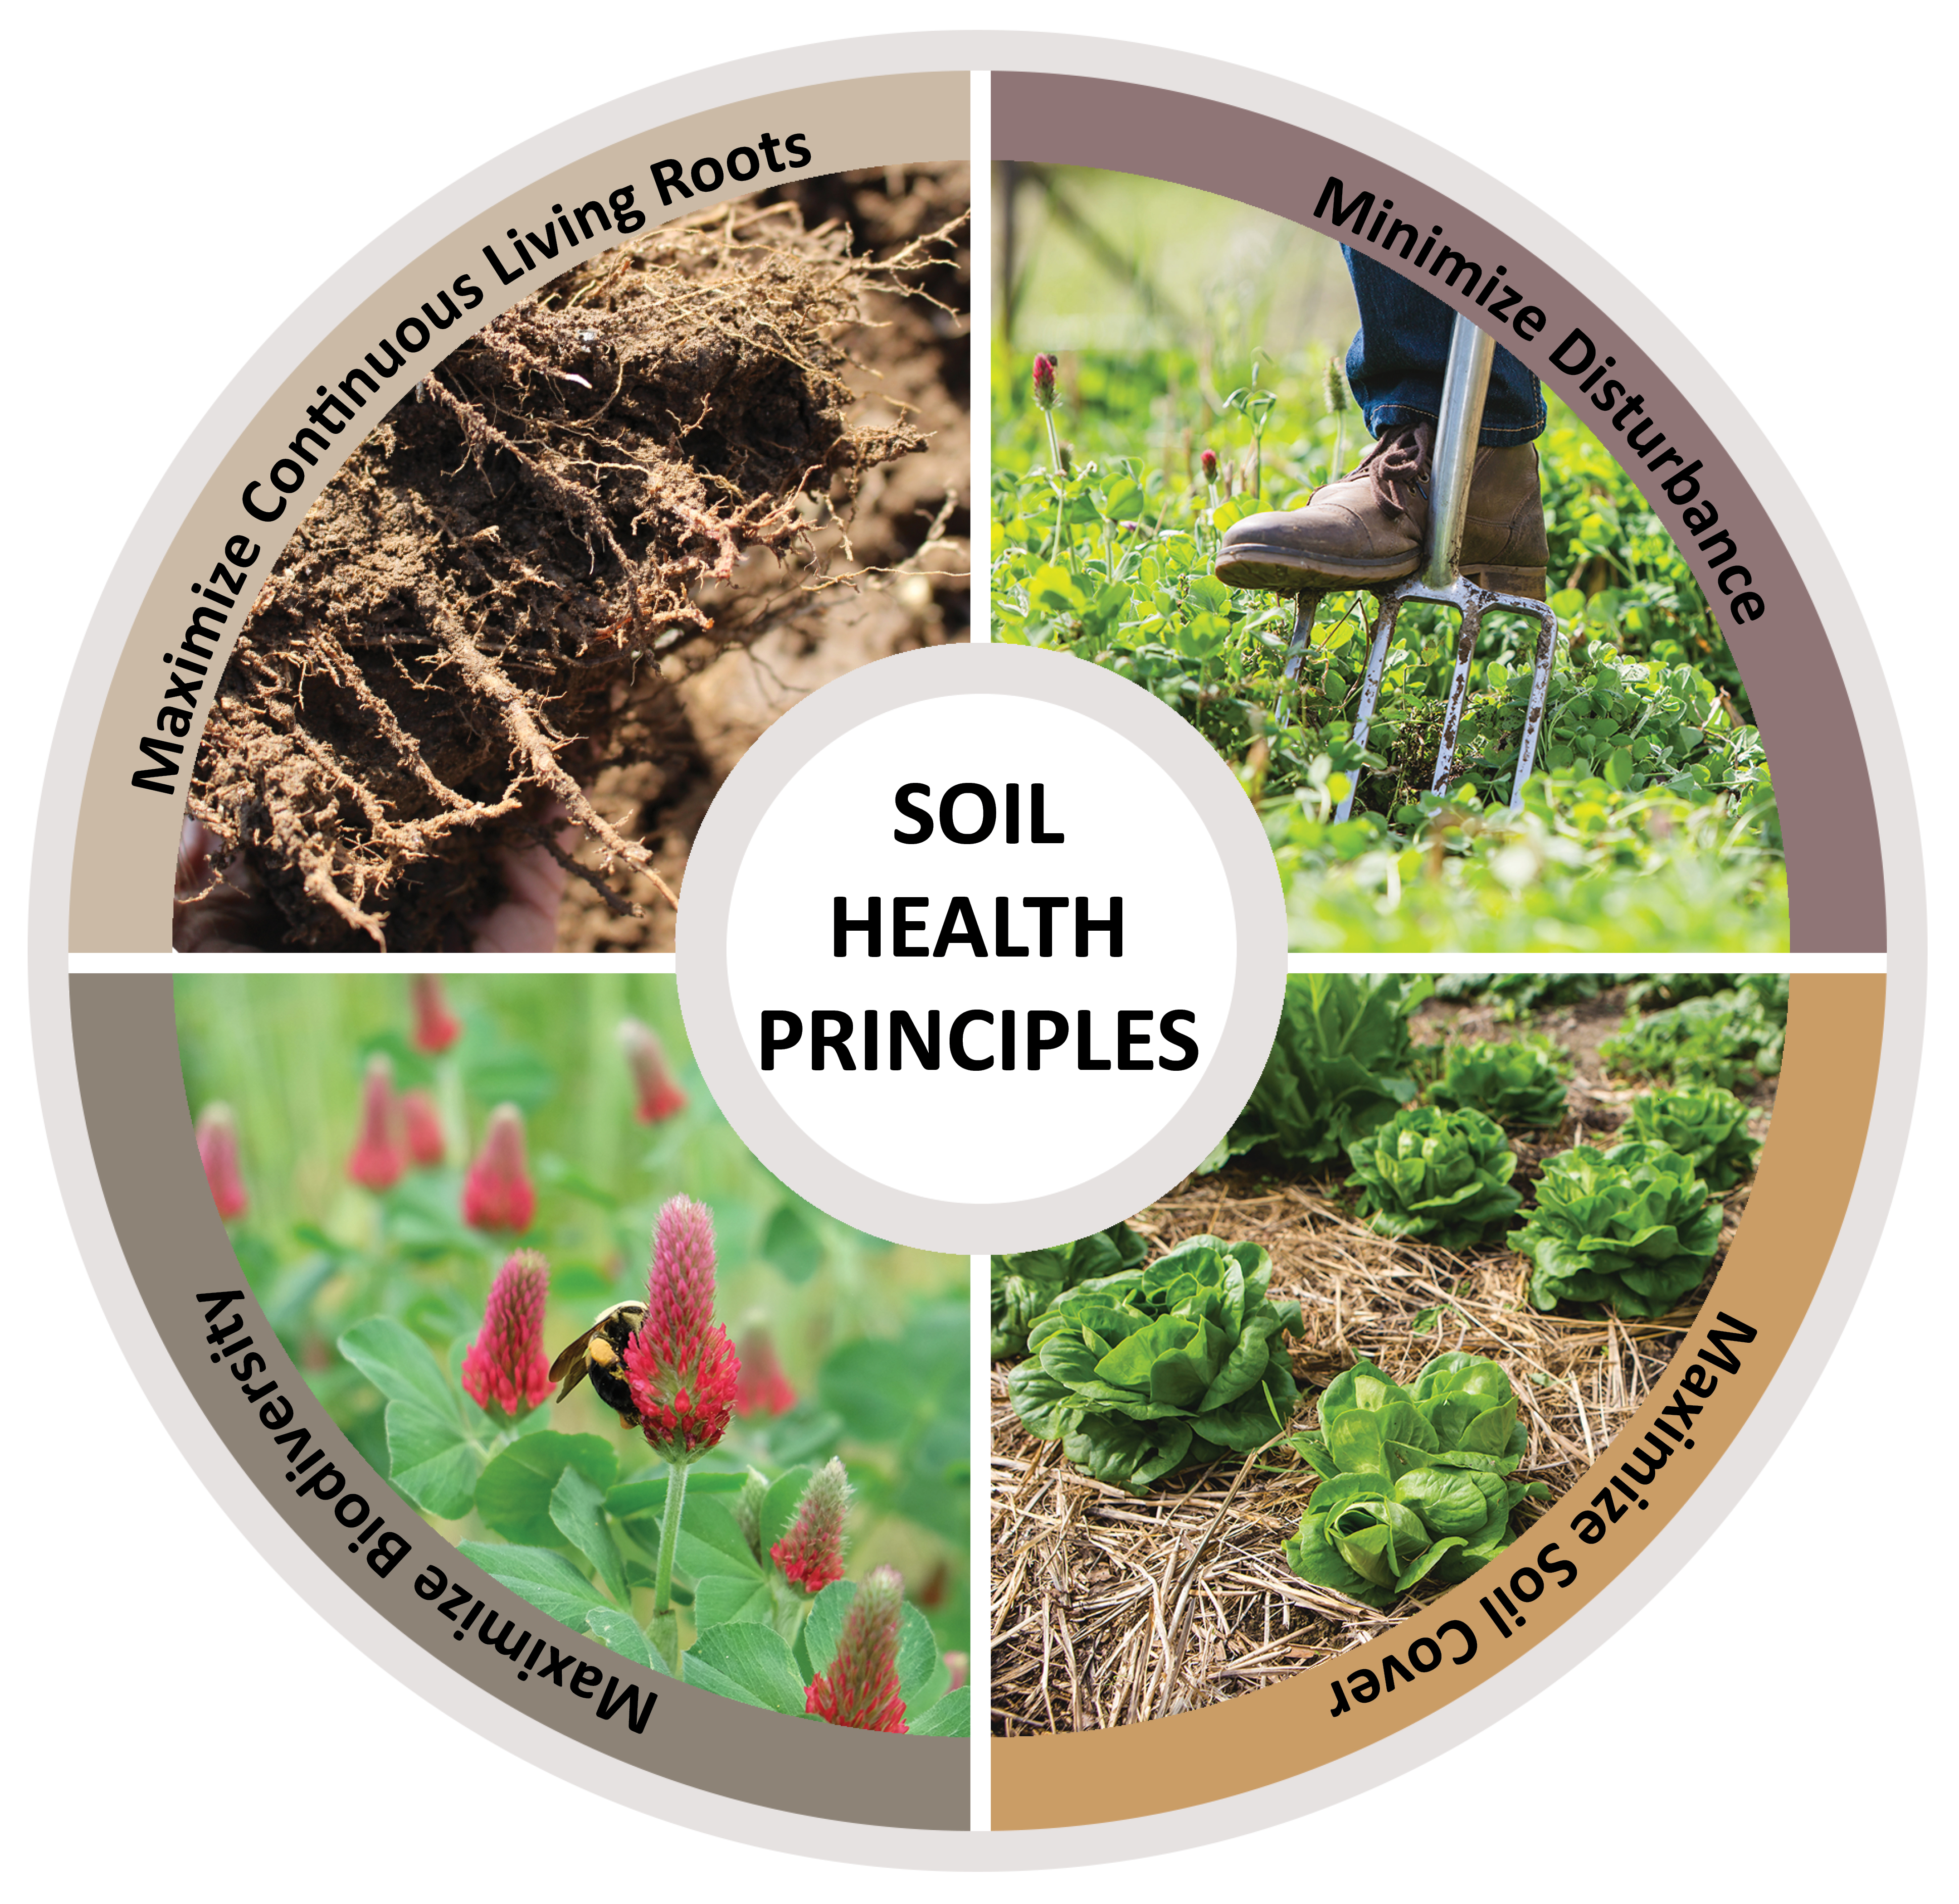
Four Principles of Soil Health and Small Farms
Minimize Disturbance
Maximize Cover
Maximize Biodiversity
Maximize Continuous Living Roots
Notes:
Once we have a good understanding of soil inherent properties versus dynamic properties, we can talk about the four principles of soil health. We use these four principles to increase the biological life in the soil. Ask participants to repeat out loud the 4 principles of soil health. For the rest of the course we will talk about the 4 principles and how to improve them including NRCS practices that address them.

Slide 15
How do we improve soil health?
Feed and Protect Soil Biology
Feed and Fuel Soil Biology
Protect Soil Aggregates, Moisture, and Organic Matter
Notes:
The NRCS proposes 4 basic principles of managing for soil health. These are:
And can be distilled down to two broad categories
Feed diverse, continuous inputs (C sources, energy)
Protect habitat (aggregates and organic matter)
Maintain SOM & aggregates; Reduce erosion & runoff risk
Buffer temperature; Reduce evaporation
Feed: Break disease cycles; Stimulate microbial diversity; Increase SOM and nutrient cycling
Enhance plant growth; Increase predator & pollinator populations

Slide 16
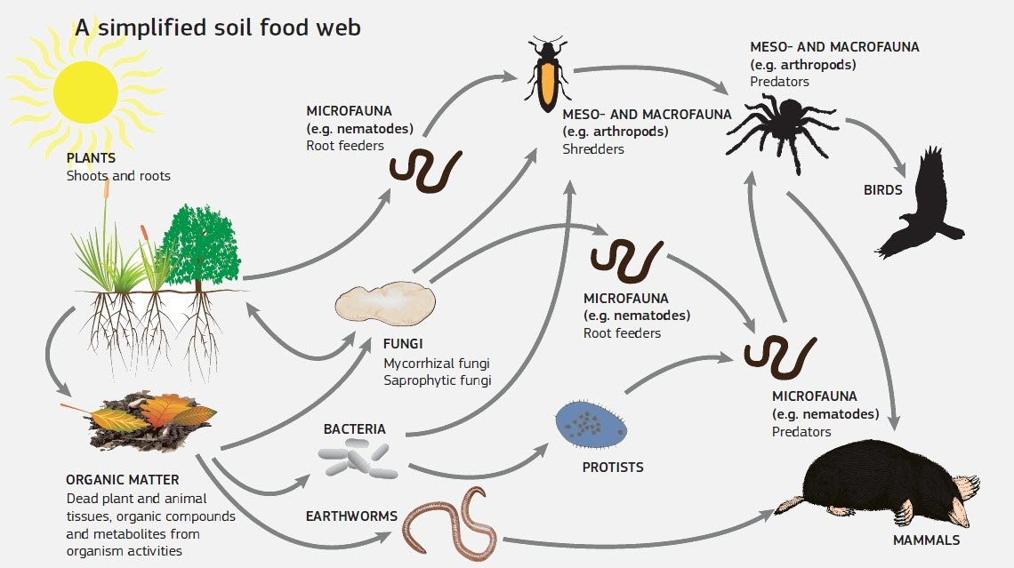
Soil Biology – Why Does it Matter?
Global Soil Biodiversity Atlas. 2016. Orgiazzi, Bardgett, Barrios et al. Luxembourg, European Commission, Publications Office of the European Union: 176p.
Notes:
What does this slide mean to you?
Historically, soil biodiversity was studied by mapping the soil food webs. This approach details the chain of energy transfer in soil and is based on grouping organisms according to their trophic role and food preferences. In a very simplistic manner, the food web is fueled by plants and photosynthetic bacteria that fix C from the atmosphere through photosynthesis. Other organisms then obtain their energy by breaking down plant residues and organic compounds or by consuming other organism. During decomposition and consumption, nutrients are converted from organic to inorganic forms and made available to plants and other soil organisms (Paraphrased from Turbe et al., 2010).
Pros of the food web approach: Very useful for understanding nutrient cycling and energy flows and provided the foundation to study functional soil biodiversity.
Limitations: overlooks other important processes not based on feeding relationships, such as soil structure development, parasitism and pathogenesis. Relies on biomass and species composition, whereas activity provides a better understanding of soil biological function.

Slide 17

Soil Biology and Nutrient Cycling and Availability (Plant Productivity and Health)
Soil biology is key to making nutrients available to plants (and animals).
If soil biological organisms are diminished, more chemical (and costly) inputs are needed for plant productivity. Don’t be a “more-on!”
Notes:
Penny exercise: Hand out a penny to each participant in the class. Ask them to hold it in their hand. Let’s suppose your doctor said you were deficient in copper. Could you absorb the copper into your system just by holding a penny? Why not? (A. It isn’t bioavailable.) What makes nutrents available? (A. Microbes.) What is one of the most abundant nutrients on earth? (A. Nitrogen) Why do farmers have to apply nitrogen fertilizer to the soil? Why can’t plants just absorb nitrogen from the air? (A. They need microbes to make it available to plants.) It is the soil life that make nutrients available to plants for growth.
Stock Image 100448578

Slide 18
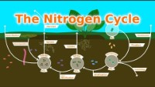
The Nitrogen Cycle:
https://www.youtube.com/watch?v=A8qTRBc8Bws

Slide 19
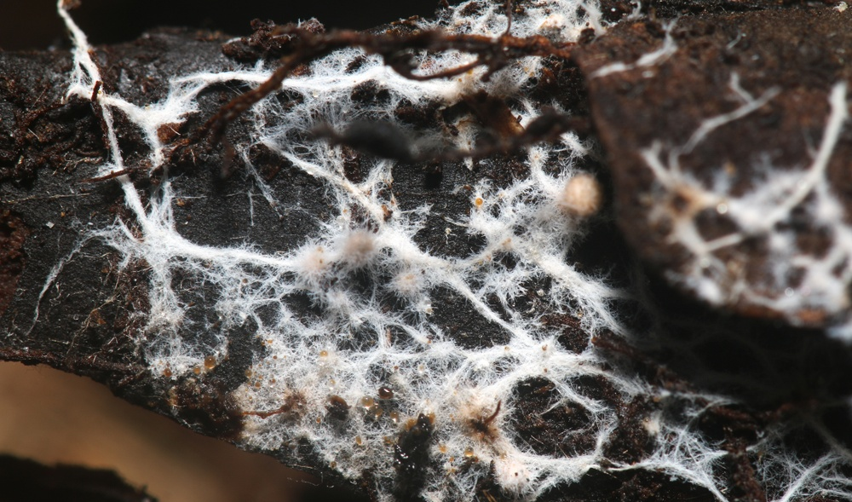
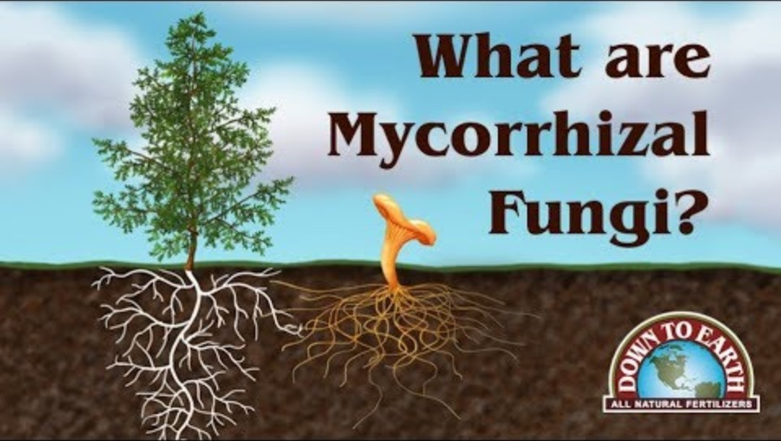
Mycorrhizal Fungi
https://youtu.be/0oyqPZJj-2w

Slide 20
Soil Glues, Glomalin, and Root Exudates
Notes:
Add information at a later date.

Slide 21
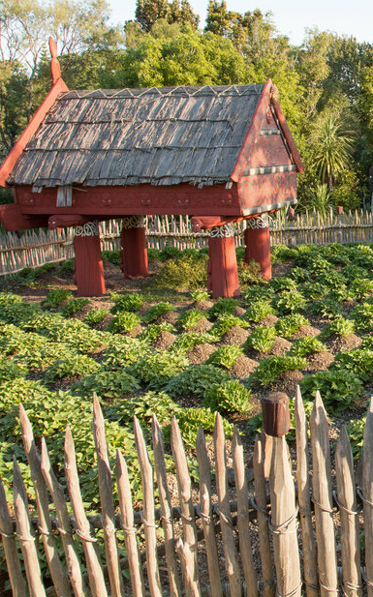
Pair and Share:
In New Zealand, the Maori people view soil as an ancestor and are advocating for it to have “personhood.” If your soil was to have all of the rights of a person, how would that change the way you treat it?
Notes:
Ask participants to pair up and discuss this question for 3-5 minutes. Ask people to share their answers.

Slide 22
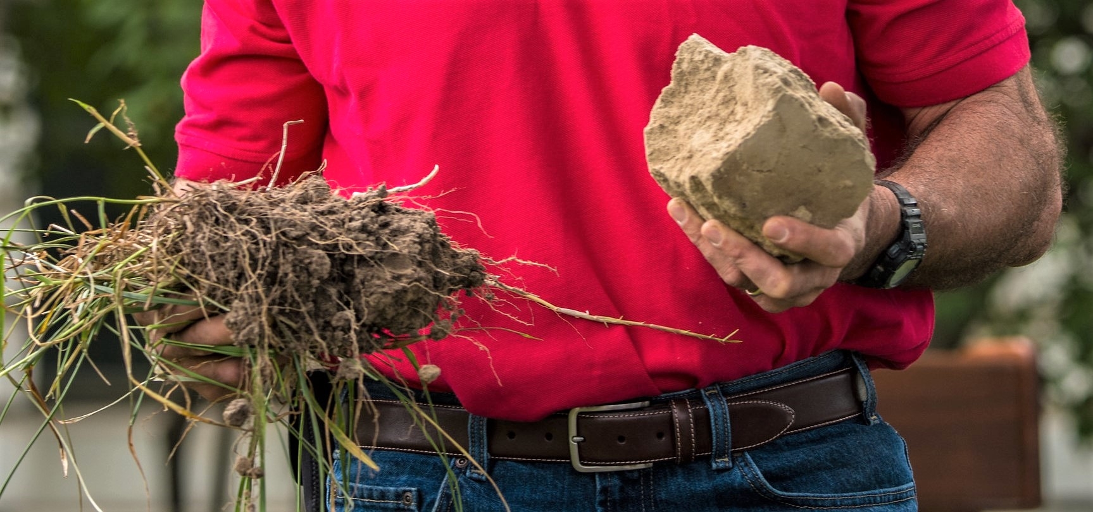
Soil Biology Influences Resource Concerns: Undisturbed (left) vs. Disturbed (right)
Notes:
Let’s look at how biological communities and roots improve drainage. Compare these two soils. These are the same soil type but different management – untilled versus tilled. The soil on the left was in a no-till permanent pasture and the soil on the right was in a continuous till crop field. What do you notice about the soil on the left? Look at the soil structure. Even though it is the same soil, the structure appears completely different. The soil on the left has a lumpy, cottage cheese like consistency while the consistency of the soil on the right is very fine, like it has been sifted. The clumps on the left are formed by living organisms in the soil that excrete glues which hold the soil together. Only by not disturbing the soil will these soil microorganisms survive. The soil on the right, which has fewer biological organisms, will tend to dissolve in water.

Slide 23
General Indicators of Functioning Soil Biology* (note – these may be different in different parts of the country)
Covered soil surface
Organisms (worms, bugs, fungal threads etc.) can be seen
Vegetation and manure breaks down quickly
Fine root hairs found in abundance
Soil carbon evident (dark brown color)
Vigorous, dense plant growth
Good soil aggregation
Sweet smell

Slide 24
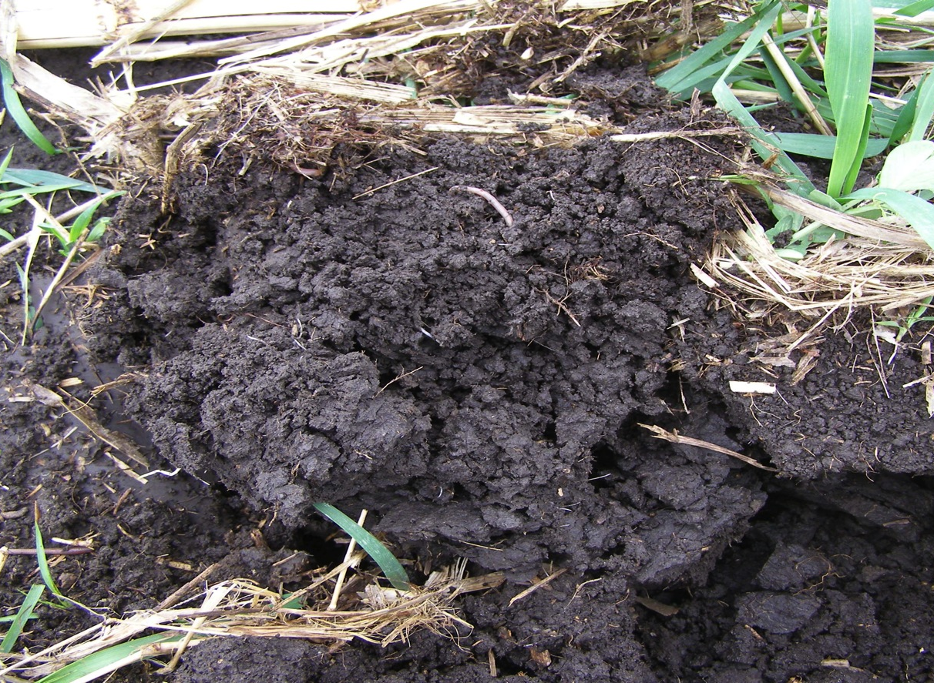
Photo of clod of healthy soil

Slide 25
General Indicators of Poor Soil Biology*
(note – these may be different in different parts of the country)
Bare soil – public enemy #1!
Low organic matter (light color)
Manure paddies/plant material that doesn’t break down quickly
Reliant on chemical inputs
pH that is out of balance for what is typical
Metallic smell
Notes:
Note! Some soils are light in color. Will want to highlight that the dark/light comparison should be made on the same type of soil.

Slide 26
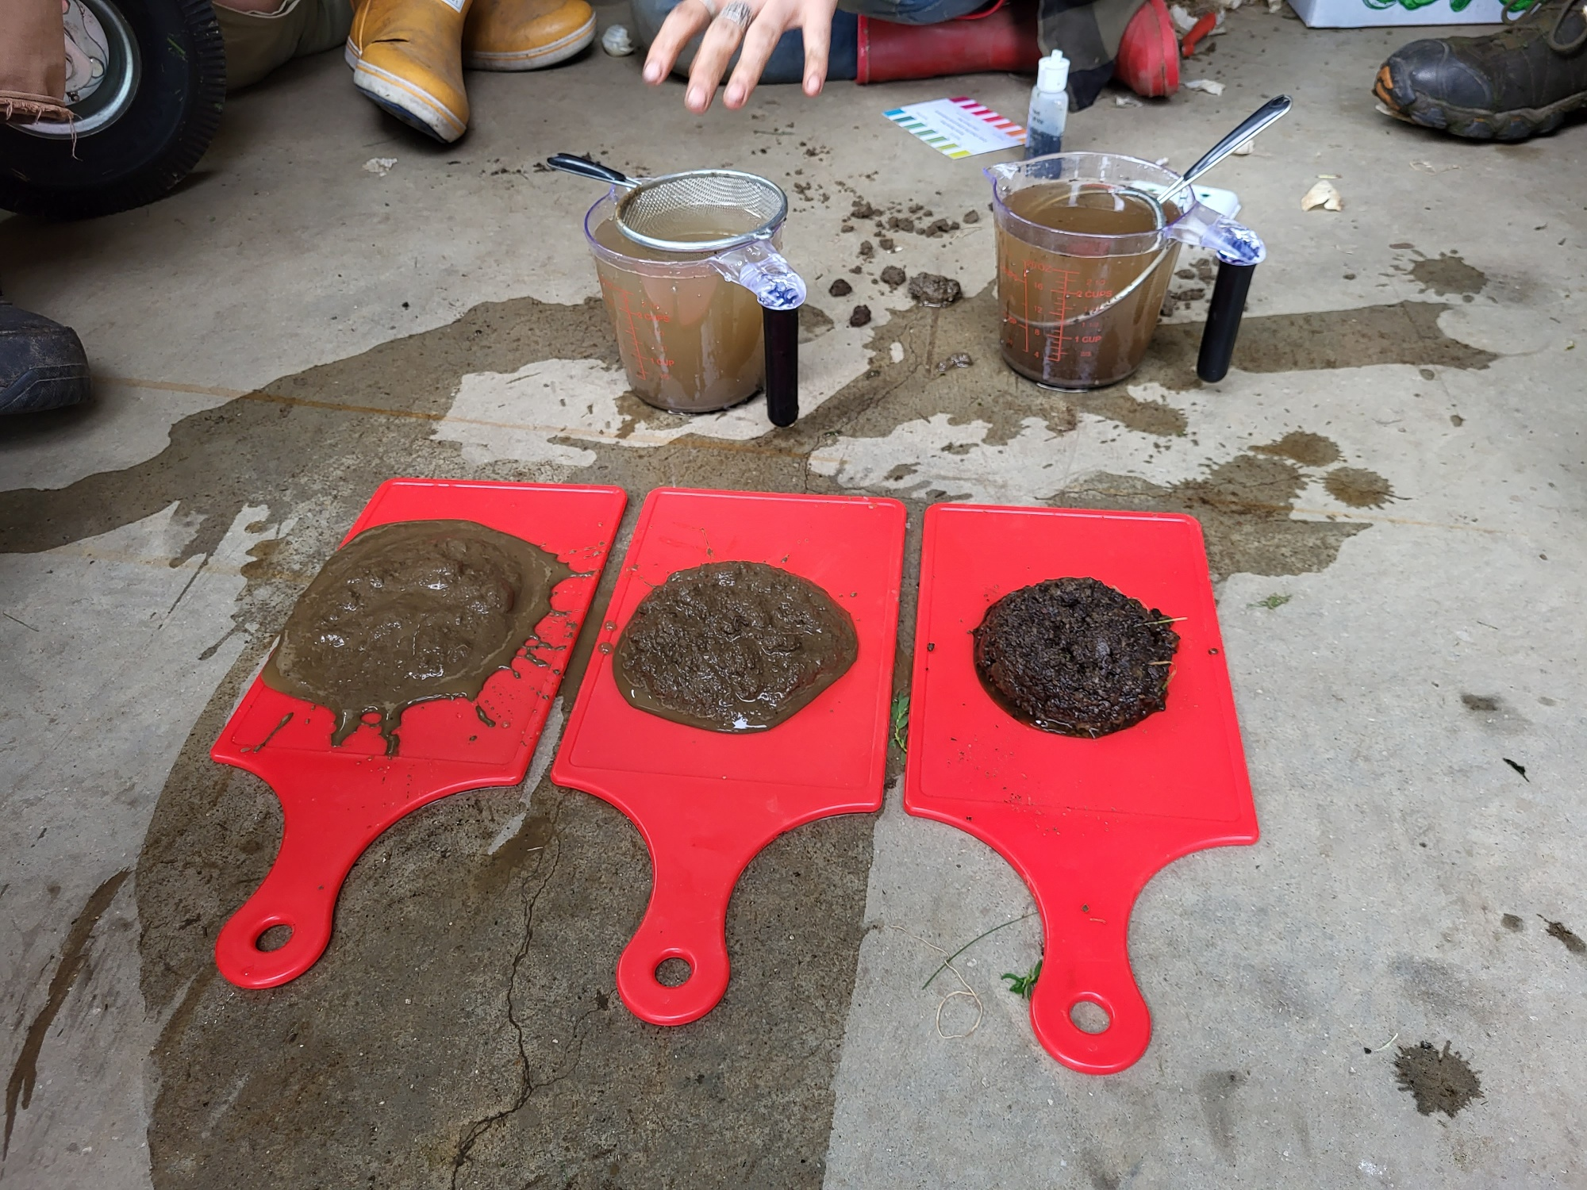
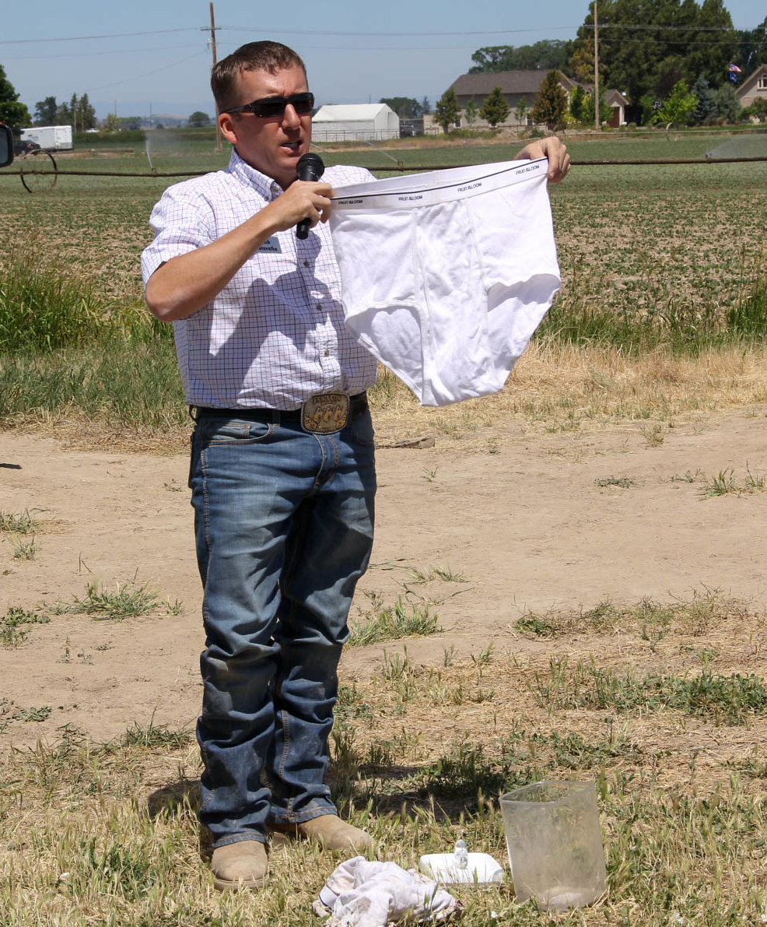
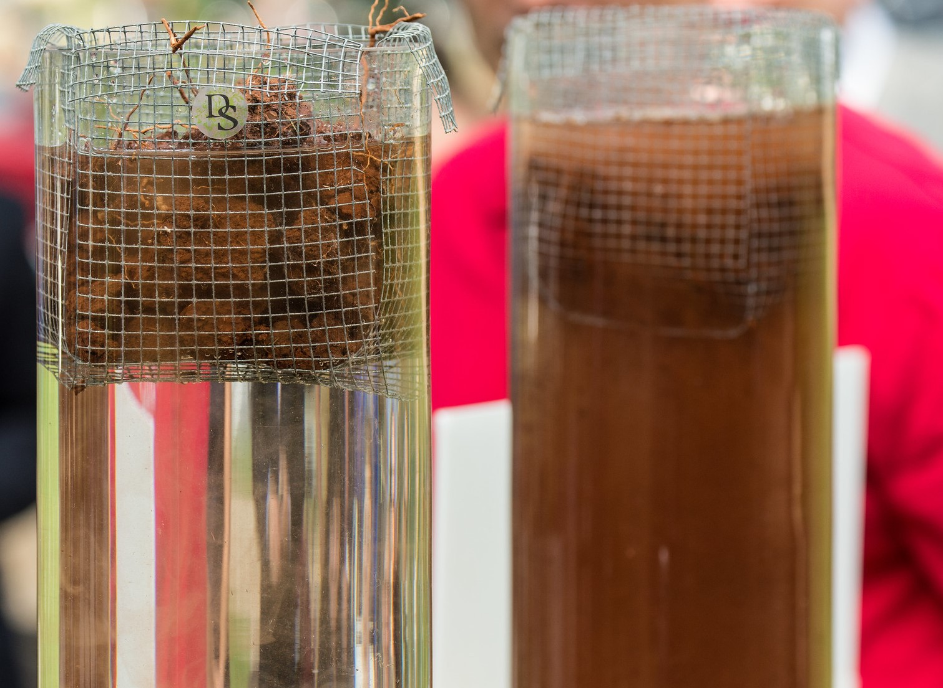
Communicating Soil Biology – Seeing is Believing: The Slump Test, “Soil Your Undies”, Slake Test, etc.
Notes:
Discuss some of your favorite ways to demonstrate soil health such as the slump test, the “soil your undies” test, and the slake test. This would be a good time to do a soil health demo in the classroom.

Slide 27
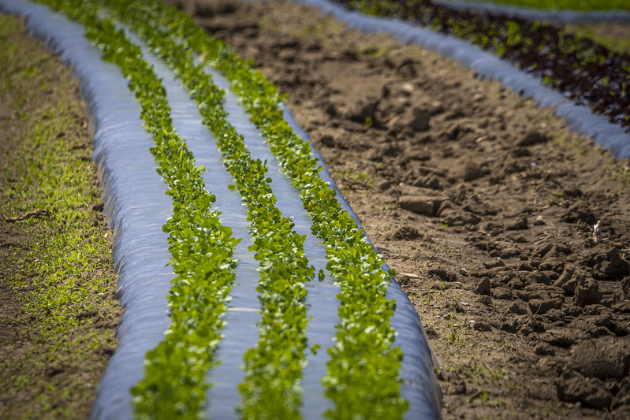
What soil health principles could be improved? What principles are being used?
(Minimize Disturbance, Maximize Soil Cover, Maximize Continuous Living Roots, Maximize Biodiversity)
Notes:
Can substitute photo for local example. Very few principles are being used in this example – the soil is tilled, there is very little cover except for the black plastic, there are no continuous living roots and little biodiversity. Ask the class how to apply the principles in this example. This could include cover crops between the rows, organic mulch such as straw, and use of zone tillage.

Slide 28
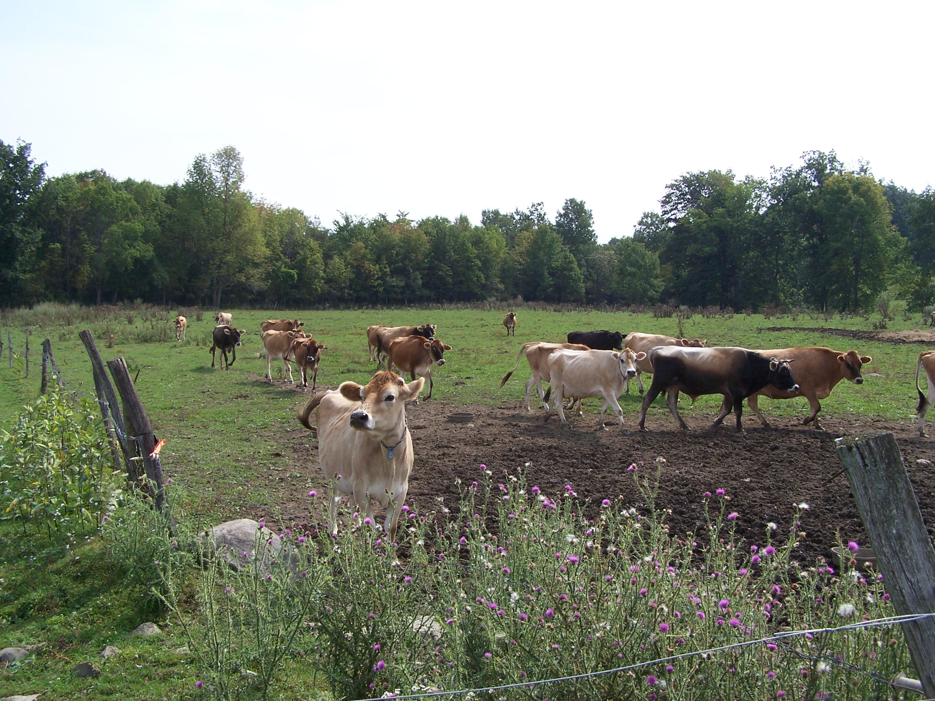
What soil health principles could be improved? What principles are being used?
(Minimize Disturbance, Maximize Soil Cover, Maximize Continuous Living Roots, Maximize Biodiversity)
Notes:
Can substitute for local example. Very few principles are being used in this example – the soil is minimally covered or not at all due to the overgrazing, there are some continuous living roots but areas of bare soil, and the disturbance is high in this continuously grazed system. There is some biodiversity in the areas along the fence line and the dairy cows are adding manure. Ask the class how to apply the principles in this example. Answers could include implementing a rotational grazing system, moving the area where the cows are fed so it is not in the same spot.

Slide 29
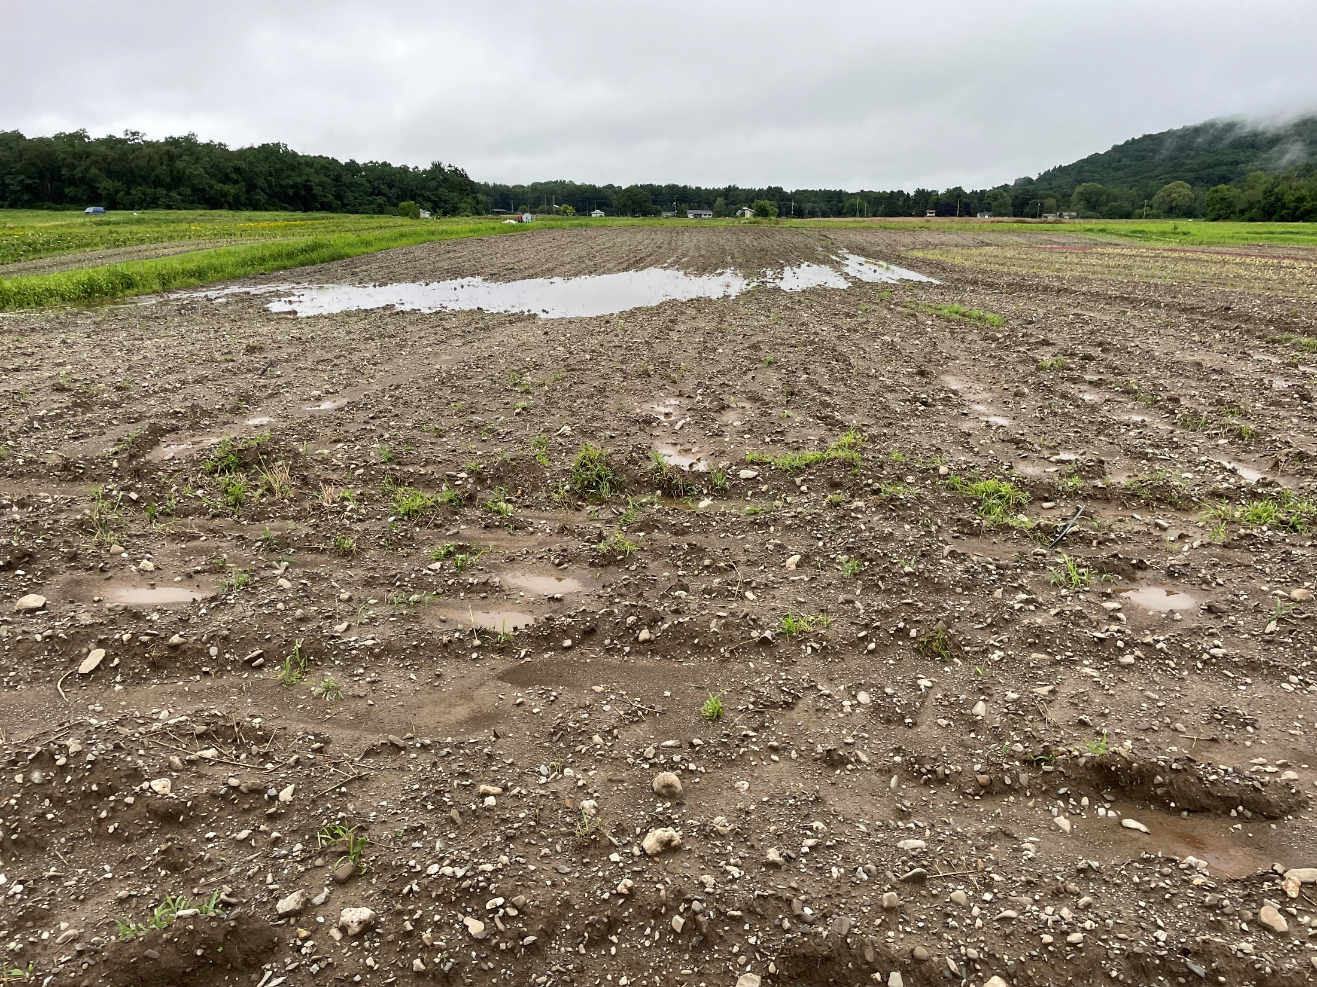
What soil health principles could be improved? What principles are being used?
(Minimize Disturbance, Maximize Soil Cover, Maximize Continuous Living Roots, Maximize Biodiversity)
Notes:
Can substitute for local example. This is a photo of a tilled field at a flower farm. Even though the soils are excessively well drained, the farm was experiencing ponding and was asking about drainage tile. Very few principles are being used – the soil is tilled, there is no cover, no continuous living roots and no biodiversity. Ask the class how to apply the principles in this example. This could include winter cover crops, zone tillage with permanent vegetation in the rows, or perennial vegetation in the low-lying areas such as pussy willows, button bush or winterberry.

Slide 30
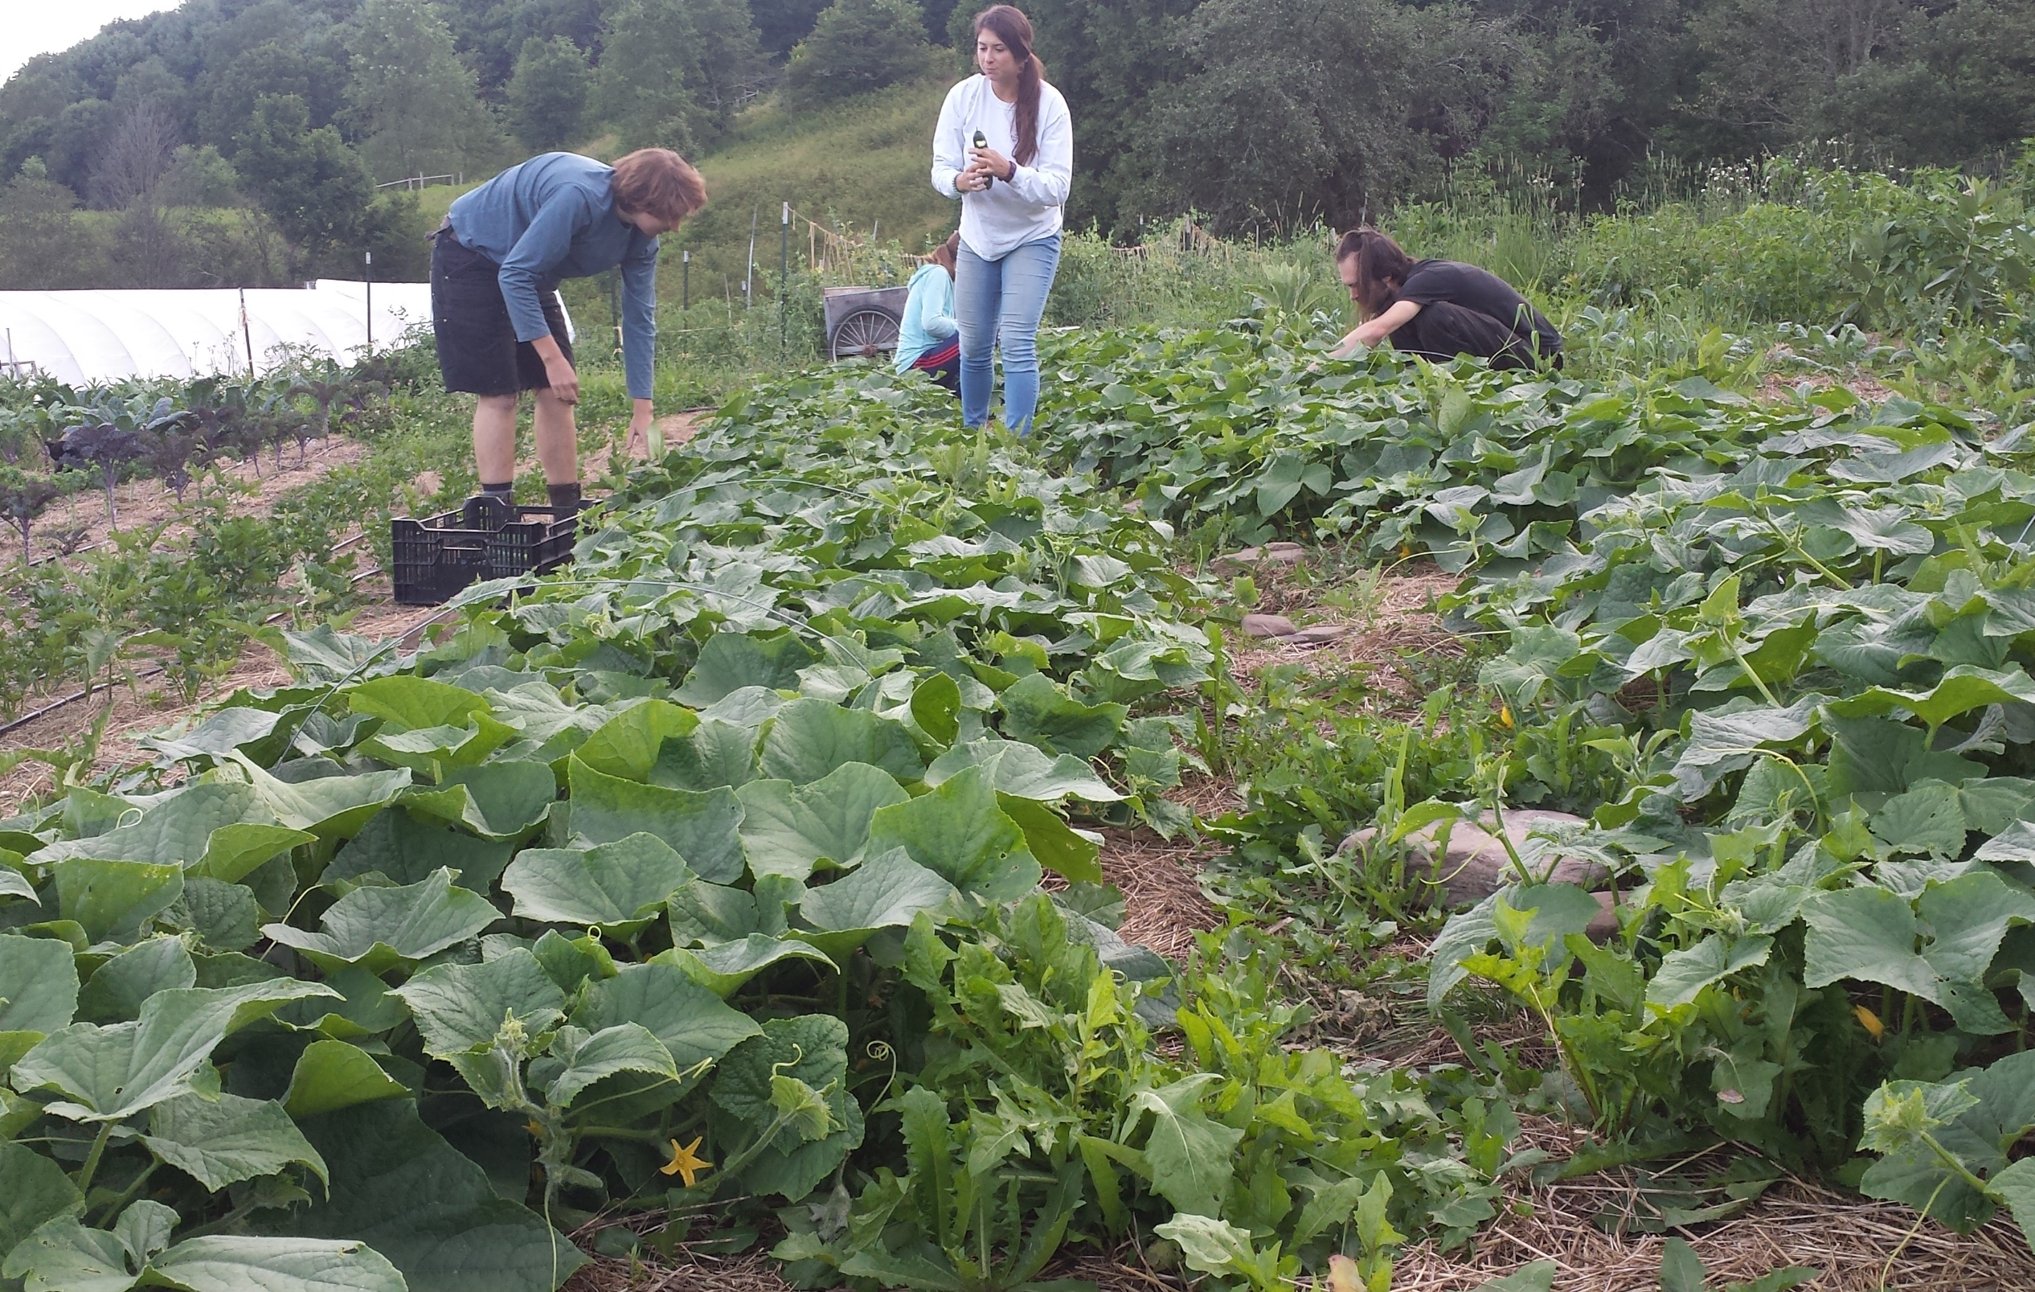
What soil health principles could be improved? What principles are being used?
(Minimize Disturbance, Maximize Soil Cover, Maximize Continuous Living Roots, Maximize Biodiversity)

Slide 31
What soil health principles could be improved? What principles are being used?
(Minimize Disturbance, Maximize Soil Cover, Maximize Continuous Living Roots, Maximize Biodiversity)
Notes:
Can substitute for local example. This is a photo of a tilled field at a flower farm. Even though the soils are excessively well drained, the farm was experiencing ponding and was asking about drainage tile. Very few principles are being used – the soil is tilled, there is no cover, no continuous living roots and no biodiversity. Ask the class how to apply the principles in this example. This could include winter cover crops, zone tillage with permanent vegetation in the rows, or perennial vegetation in the low-lying areas such as pussy willows, button bush or winterberry.

Slide 32
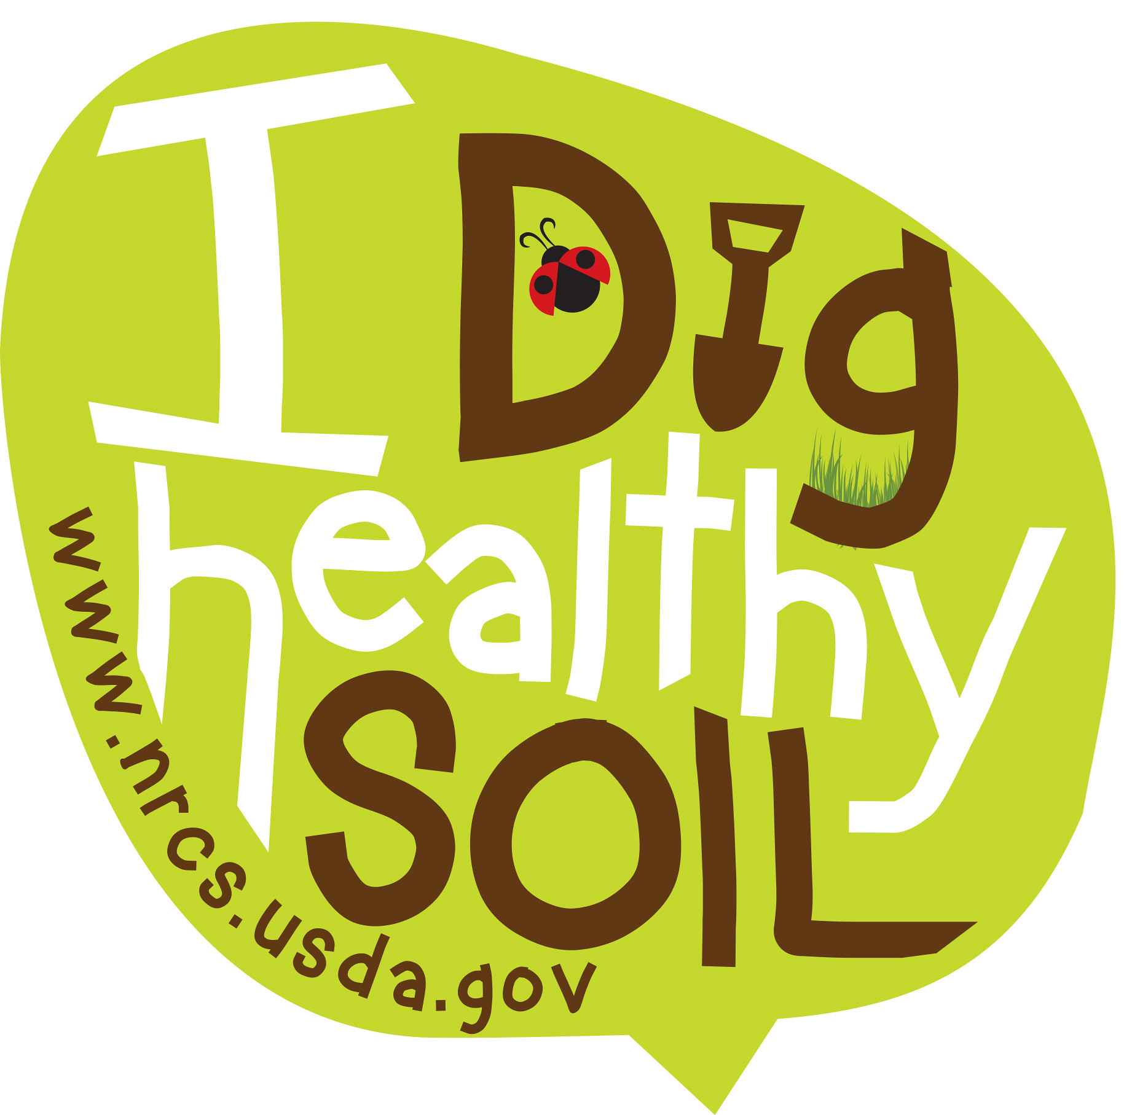
Review and Questions?
Soils have 3 different properties – physical, chemical, and biological.
Soil biological properties play a part in resource concerns such as plant productivity and health, aggregate instability, erosion, compaction, and ponding.
The practices under the four principles of soil health help feed and protect soil biology.
The four principles are: minimize disturbance, maximize cover, maximize living roots, and maximize diversity.

Slide 33
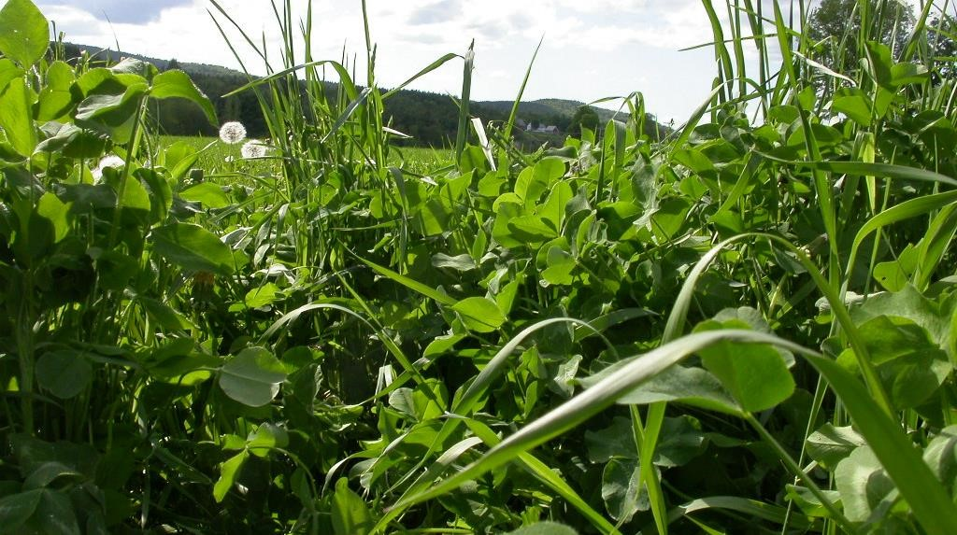
This information is provided as a public service and constitutes no endorsement by the United States Department of Agriculture or the Natural Resources Conservation Service of any service, supply, or equipment listed.
While an effort has been made to provide a complete and accurate listing of services, supplies, and equipment, omissions or other errors may occur and, therefore, other available sources of information should be consulted
The USDA is an equal opportunity provider and employer.
Meeh, NRCS

